Slide 1
Scratch
and Batch
Cooking
07/28/22

Slide 2
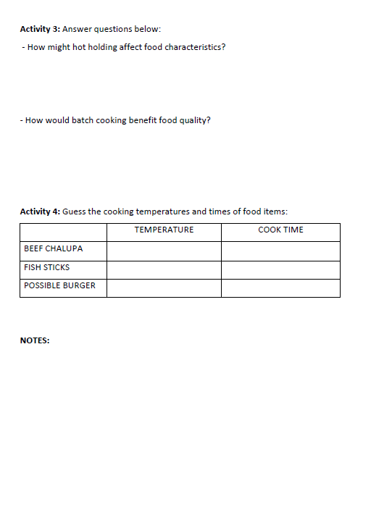
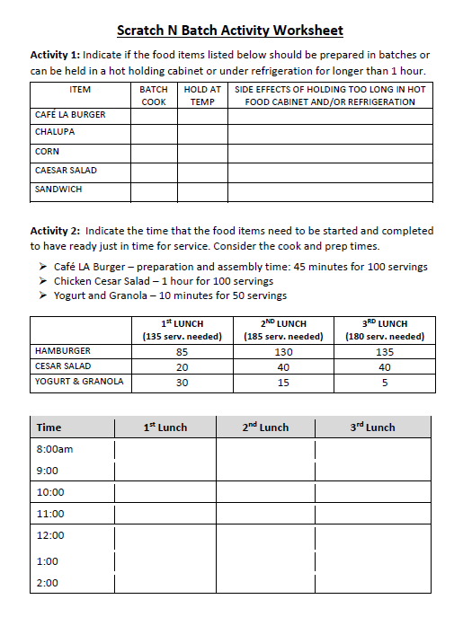
Activity Worksheet Print Out
Before beginning this training, have in front of you the Scratch N’ Batch Activity Worksheet to follow along with activities.
Have a great training!

Slide 3
Food Services Goal
Elevate school nutrition with fresher, healthier and more appealing options.
Apply fundamentals of food service to reach new goals
Follow cooking guidelines to make food appetizing
Focus on customer taste preferences
Offer innovative food options and varieties to drive participation
Incorporate student feedback

Slide 4
Focus on Food Preparation
Café LA continues to meet the nutritional needs of our students to achieve excellence. Although some service practices have faded (grab and go), safe cooking and food preparation never go out of style in the kitchen.
The following topics are focus areas for our cafeterias:
Scratch cooking
Batch cooking
Kitchen basics
Following standardized recipes

Slide 5
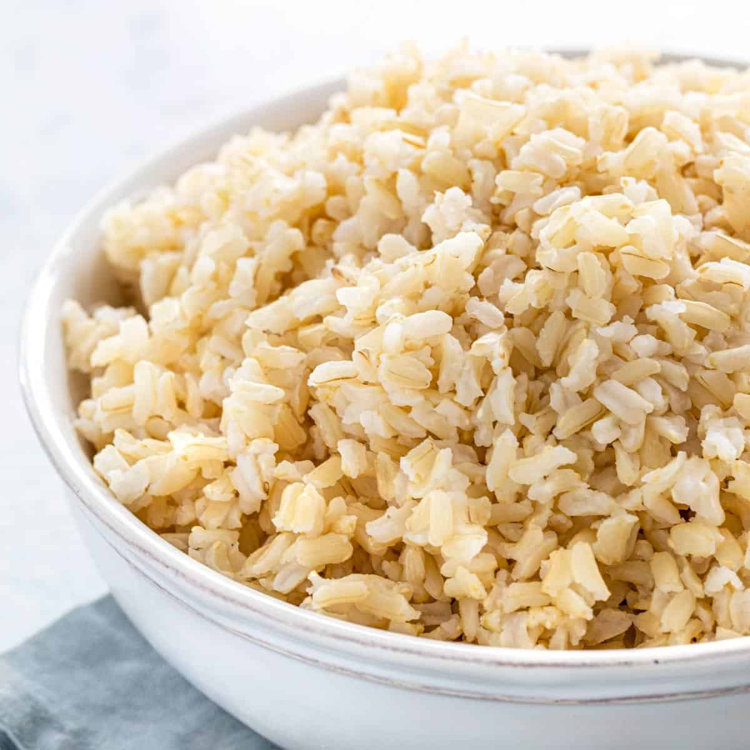
Scratch Cooking
Scratch cooking refers to the process of utilizing raw proteins, whole grains, fresh fruits and vegetables to create a meal.
Café LA incorporates a “semi-scratch” cooking method to prepare meals. Semi-scratch cooking is utilizing both raw foods and pre-cooked foods to create a meal.
Teriyaki bowl (brown rice and chicken)
Caesar salad (fresh salad and chicken)

Slide 6
Benefits & Challenges of Scratch Cooking
BENEFIT
CHALLENGE
Scratch cooking leads to food that taste better. When food has not been previously cooked and frozen, there is more flavor still held in the food. Cooking from scratch also brings out the chef in us all!
Scratch cooking can require more prep time and not always cost effective. Because food is from a raw state, cooking times can also be extended.

Slide 7
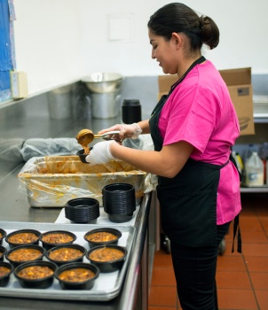
Batch Cooking
Batch cooking is a method of preparing food in small batches as needed throughout the serving period.
Batch cooking can be accomplished with both raw ingredients and precooked ingredients.
Batch cooking is also referred to as, “Just-in-Time” cooking.

Slide 8
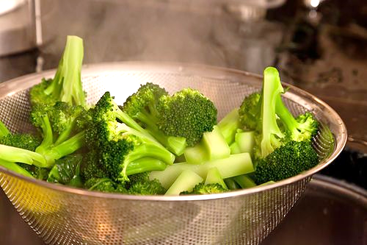
Benefits of Batch Cooking
Batch cooking reduces the amount of time food is held at holding temperatures.
Promotes freshly cooked food
Preserves food quality
Reduces food costs and product waste

Slide 9
Food Quality & Waste Reduction
Batch cooking protects the quality of prepared food and reduces waste.
Food Quality
Reduced Waste
Cooking food in small batches allows for a higher nutrient content and a fresher tasting product. As a bonus, food looks fresher and better!
Staff has the ability to scale back or increase the amount of food prepared if they find that a particular food item is not as popular or more popular as anticipated.

Slide 10
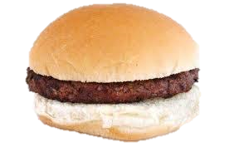
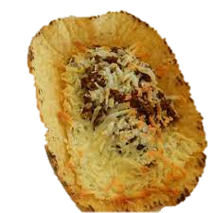
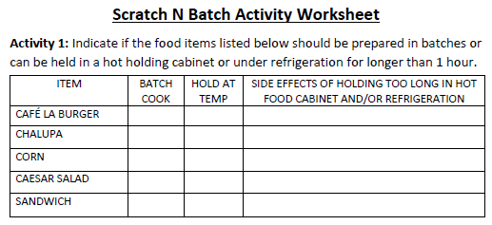
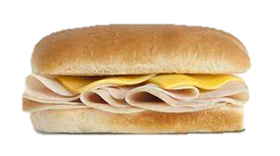
Batch Cooking vs Hot/Cold Holding
Using the activity worksheet, organize the items that should be prepared in batches versus food that could be held for longer than 1 hour.
List the possible side effects of holding food item for longer than 1 hour in warmer. Example: Bread will get hard
1 Minute Timer

Slide 11
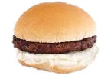
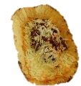
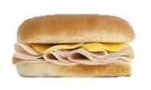
Batch Cooking vs Hot/Cold Holding
Review answers for Activity 1

Slide 12
Hot Holding Cabinet
Hot holding cabinet* (food warmer) should be ideally set to 140°F. When hot food is placed inside the warmer, the internal temperature increases. After opening the door, heat is released, reducing internal temperature.
If the temperature is set too high, food will overcook
If the temperature is too low, food will not hold at a safe holding temperature
To keep food moist, maintain an adequate amount of water in water tray
*If warmer is not operating correctly, input M&O ticket for repair.

Slide 13
Just-In-Time Preparation
It is the Food Service Managers (FSM) responsibility to plan the food production and work schedules.
The food service staff’s role is to follow the set schedules to ensure that the items on the service line are at peak quality.
The goal is to place the menu item on the service line “just-in-time” for selection and consumption by customer.
Holding food inside the hot holding cabinet for long periods of time diminishes food quality.

Slide 14
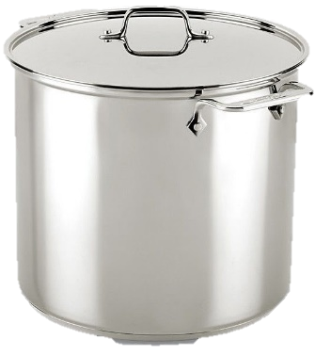
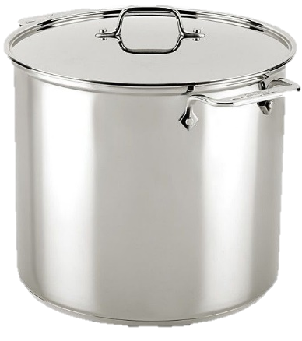
Just-In-Time Preparation Schedule
Different serving times will determine the Just-In-Time schedule.
There are other variables that need to be considered when deciding the preparation schedule:
Quantity needed per serving period
Cook times for food items
Hot/cold holding timelines

Slide 15
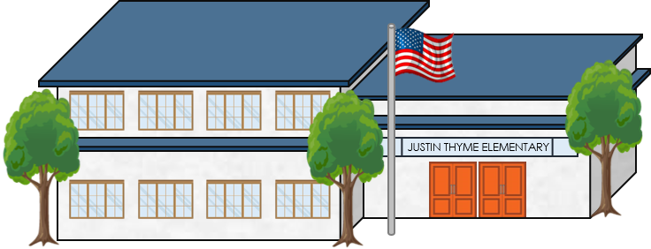
Just-In-Time Scenario
Justin Thyme Elementary serves 500 students for lunch.
There are 3 serving periods for lunch.
Today’s lunch menu has the following entree’s:
1st lunch: 11:00
2nd lunch: 11:45
3rd lunch: 12:30
Café LA Burger – preparation and assembly time: 45 min for 100 servings
Chicken Cesar Salad – 1 hour for 100 servings
Yogurt and Granola – 10 minutes for 50 servings

Slide 16
Just-In-Time Practice Worksheet
On your worksheet, rank the time the food items need to be started and completed to have ready just in time for service.
Use the projected servings per serving period to help make determination
Total Projected Serving
Hamburger: 350
Salad: 100
Yogurt: 50
 | 1st LUNCH (135 servings) | 2ND LUNCH (185 servings) | 3RD LUNCH (180 servings)
HAMBURGER | 85 | 130 | 135
CESAR SALAD | 20 | 40 | 40
YOGURT & GRANOLA | 30 | 15 | 5

Slide 17
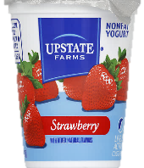
Just-In-Time Practice Worksheet
1st lunch: 11:00
2nd lunch: 11:45
3rd lunch: 12:30
Time | 1st Lunch | 2nd Lunch | 3rd Lunch
8:00am
9:00
10:00
11:00
12:00
1:00
2:00
 | 1st LUNCH (135 servings) | 2ND LUNCH (185 servings) | 3RD LUNCH (180 servings)
HAMBURGER | 85 | 130 | 135
CESAR SALAD | 20 | 40 | 40
YOGURT & GRANOLA | 30 | 15 | 5

Slide 18
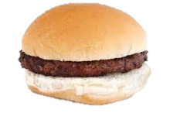
Just-In-Time Practice Worksheet
Salads can be prepared first thing in the morning. They can be held in refrigerator until lunch time.
Time | 1st Lunch | 2nd Lunch | 3rd Lunch
8:00am
9:00
10:00
11:00
12:00
1:00
2:00
Burgers needs time to cook, then assemble and wrap (45 min for 100)
1st lunch: 10am / 2nd lunch: 10:30 / 3rd lunch 11:00
Yogurt and granola can be held in refrigerator until just before service
1st lunch: 10:45 / 2nd lunch: 11:30 / 3rd lunch 12:30

Slide 19
Café LA Gold Standard
The Gold Standard is a level of quality, desirable for all food prepared in the cafeteria. Food prepared according to the Gold Standard should be:
Visually appealing
Uniform assembly
Consistent portions
Prepared according to recipe

Slide 20
Quality Standards
We strive to meet the “Gold Standard” in all of our Café LA kitchens. In order to meet this standard, you should always ask yourself:
Would batch cooking improve the quality of the food being prepared?
How will the quality of food items affect customer satisfaction?
Recipe instructions should always be followed to meet quality standards.

Slide 21
Food Characteristics
Food has a set of desirable characteristics that make it appealing. We use our 5 senses when eating:
Taste
Color
(taste)
(see)
Food storage and preparation can have an impact on final taste of food.
Food should have its natural color. Discoloration may signal food is spoiled.
Texture
Aroma
(feel / hear)
(smell)
Crunchy food should be crunchy. Soft food should be soft.
Burnt or spoiled food will have an unpleasant odor.

Slide 22
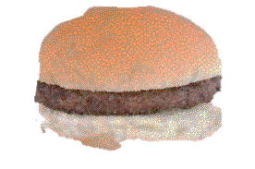
Compromised Food Characteristics
Once food is cooked, its characteristics begin to change. The more often and the longer food is held at high temperatures, its characteristics become compromised.
On your Activity Worksheet, answer the following questions:
How might hot holding affect food characteristics?
How would batch cooking benefit food quality?
1 Minute Timer

Slide 23
Food Appeal
It's been said that we, “Eat with our eyes!” This means that we first take in food visually. Our goal is to make food look good before tasting it.
When displaying food on the service line, keep it organized
Burnt or rotten food should be discarded and accounted for
Clean any surrounding spills or crumbs from serving line

Slide 24
Service Area Appeal
Before beginning service, walk out to your service line or window and look to see what your customer sees. Is the area presentable, does it look appealing?
If at an elementary site, set your eye level at the children's eye level
After each serving period, reassess the area for appeal

Slide 25
Working With Food
To prepare food successfully, we must first remember the basics of working with food; safety and efficiency.
Knives cause more disabling injuries than any other hand tool
Burns are the most common injury in the kitchen
Advance food preparation saves time and money
Successfully working with a team increases productivity

Slide 26
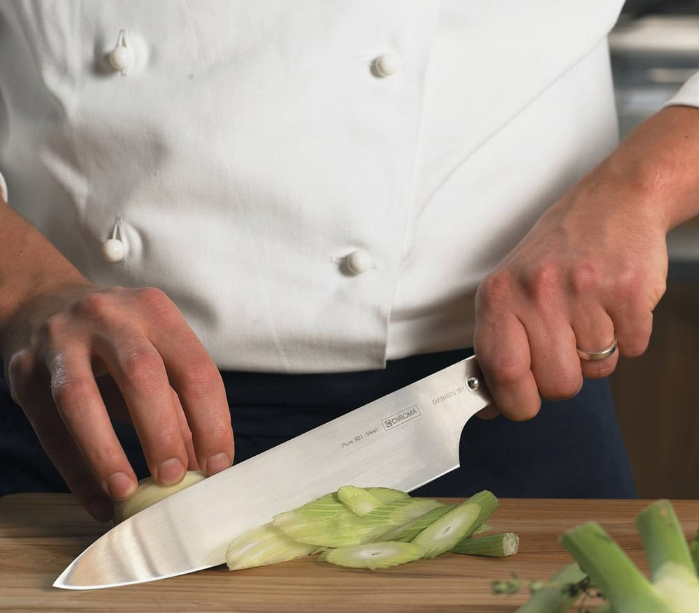
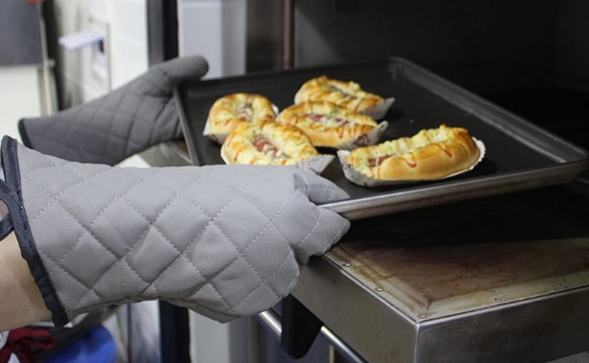
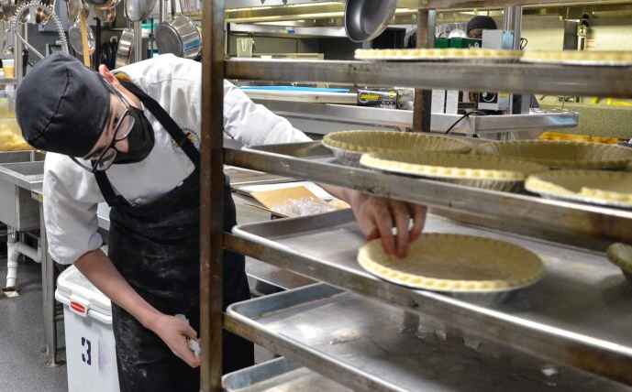
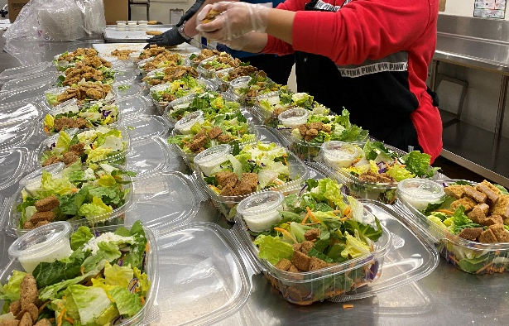
Kitchen Basics
Café LA utilizes a variety of tasks and procedures for safety and operational efficiency. Basic practices keep employees safe and our operation running smoothly. Kitchen basics include:
Safe knife handling
Handling boiling water and hot pans
Preparing a day in advance
Production line model

Slide 27
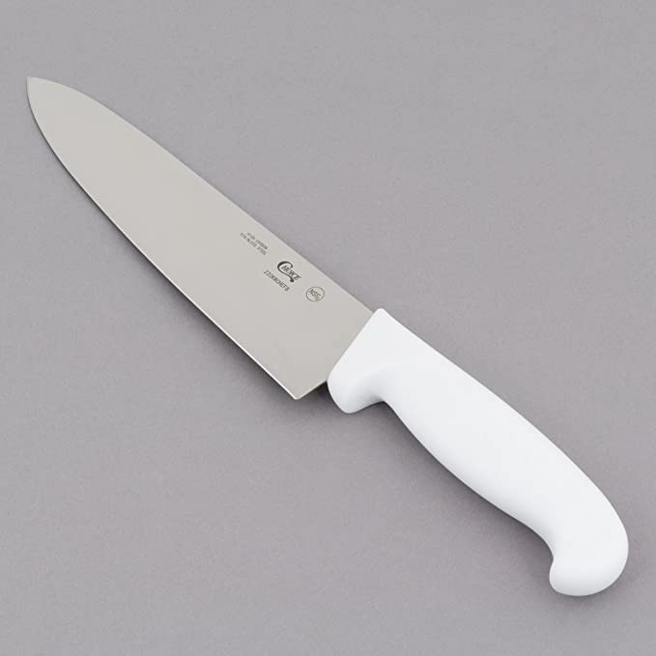
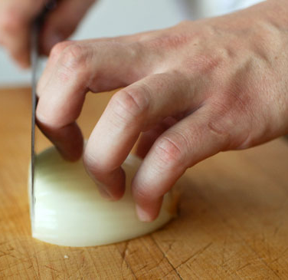
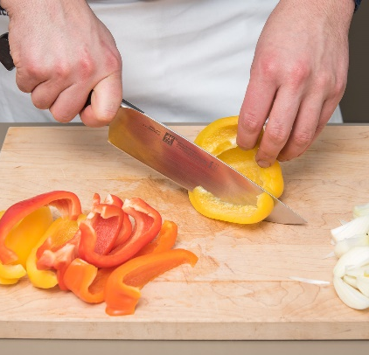
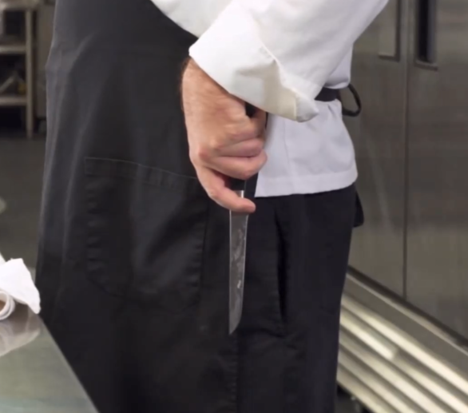
Safe Knife Handling
Improper knife handling can have serious consequences. When preparing food from scratch, there may be various food items that need to be cut, chopped or sliced.
Always use a sharp knife
Curl fingers in when cutting food
Cut away from body
When moving with knife, carry knife pointed down and notify surrounding people of sharp item coming through

Slide 28
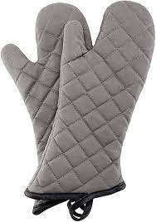
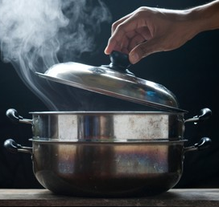
Handling Hot Pots and Pans
Burns are one of the most common accidents in the kitchen. Despite burns being common, they are highly preventable.
Handle hot equipment with oven mitts
Face away when opening a hot oven or removing the lid from a pot
When moving with a hot item, always verbalize to surrounding workers
If hot pot/pan is left on counter, verbalize to team in kitchen.

Slide 29
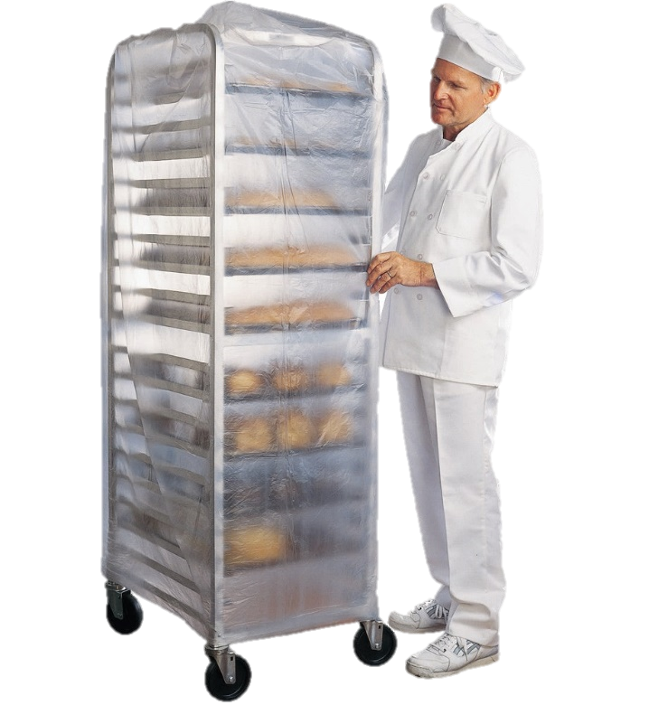
Advanced Food Preparation
There may be times when the kitchen staff can get a head start on next day’s production. Review the weekly menu for these opportunities. Food quality should always remain priority.
Convenience should not outweigh quality- do not prepare food too far ahead of time
Label all prepared food with food description and date
Store prepared food at appropriate holding temperatures.

Slide 30
Assembly Line Production Method
An assembly line is a process in which parts are added in sequence from workstation to workstation until the final assembly is produced.
When food is being assembled in the first stage, the next stage can begin preparing for the next ingredient in the assembly process.
If a menu item requires several ingredients, use an assembly line to prepare food item
Instead of one person assemble food item, use several people from start to finish

Slide 31
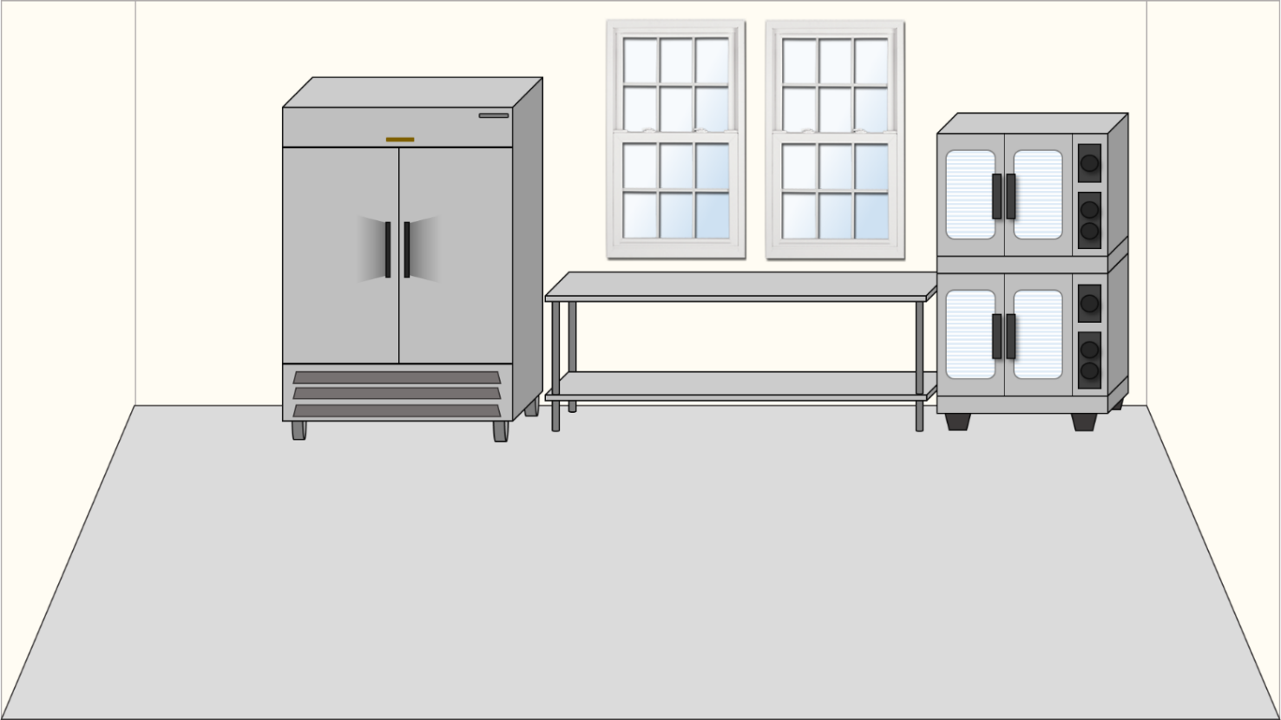
Assembly Line Scenario
Justin Thyme El. has a staff of 4 people. Using the lunch menu’s projected servings, let’s take a look at how food items can be produced using an assembly line method.
Café LA Burger – 350
Chicken Cesar Salad – 100
Yogurt & Granola – 50

Slide 32
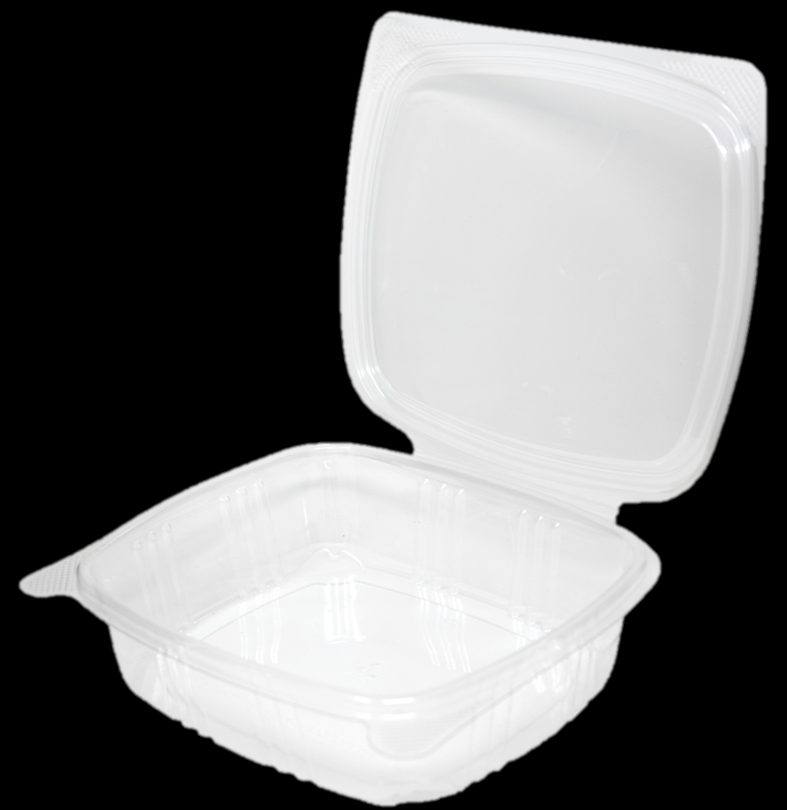
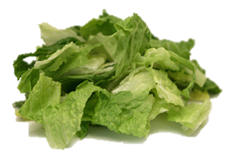
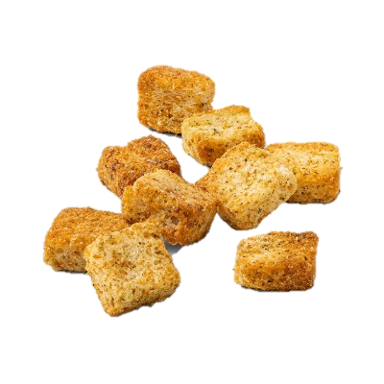
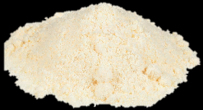
Caesar Salad Assembly Line
The Chicken Caesar Salad comprises of 5 ingredients: lettuce, chicken, croutons, parmesan cheese and salad dressing.
There are an additional 2 non-food items needed to complete: salad container and Café LA band sticker.

Slide 33
Caesar Salad Assembly
To complete 100 salads- assign two workers. Rather than have two workers assemble 50 salads each, if they work together, they will be much more efficient.

Slide 34
Caesar Salad Assembly
While Worker 1 lines up salad containers, Worker 2 can begin to prepare salad ingredients.

Slide 35
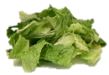
Caesar Salad Assembly
Rather than salads moving in between workstations, the workers move around each other. They will fill containers with ingredients one by one until all ingredients have been added.

Slide 36
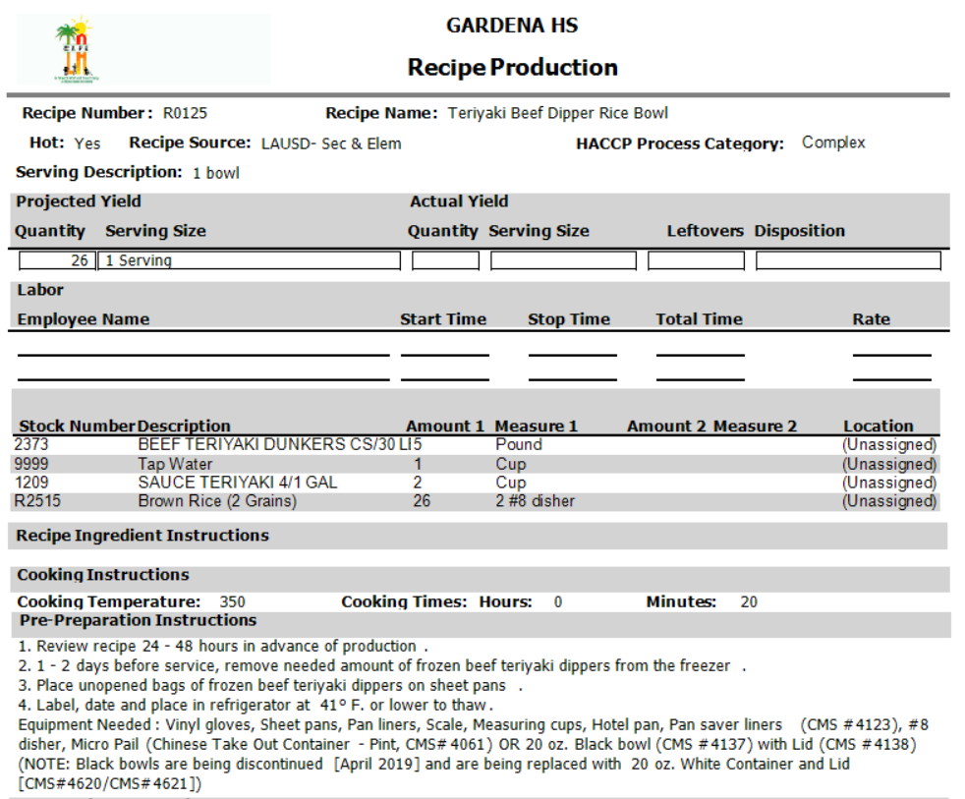
Following Recipes
In order to meet the Gold Standard at Café LA, food must be prepared according to the recipe. Not every item is cooked at the same temperature and time. Following the recipe:
Ensures consistency per serving and consistency every time the item is served in the cafeteria
Makes sure the quantity produced will meet the amount needed to serve
Leaves no room for personal influence of preparing ingredients

Slide 37
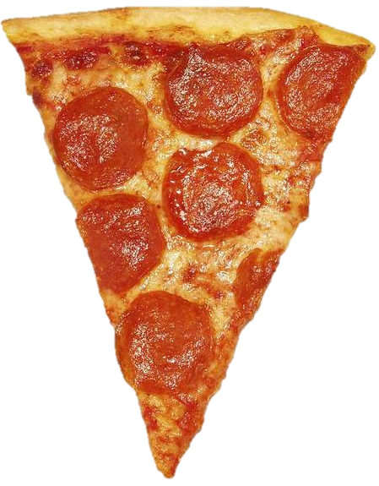
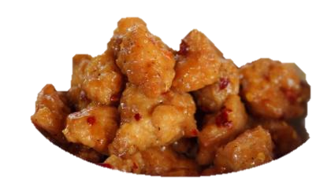
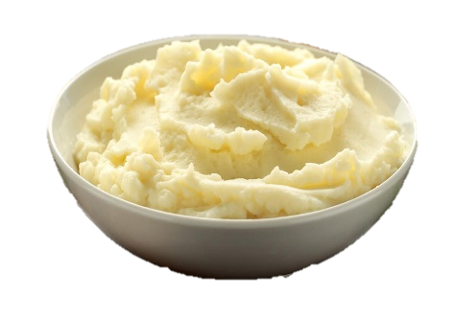
Simple Recipe
A simple recipe is one that calls for the preparation of a single food item.
Simple recipes may be for food items served individually or as an ingredient in another recipe.
Pizza
Beef burger
Orange chicken
Mashed potatoes

Slide 38
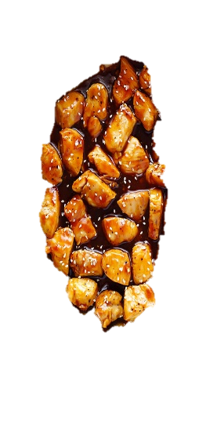
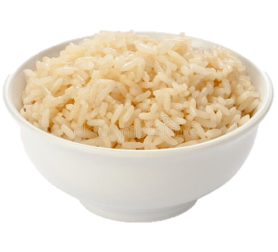
Complex Recipe
A complex recipe combines the ingredients of multiple recipes into one.
Complex recipes are dependent on other single recipe items.
Yang’s Orange Chicken & Broccoli Bowl
Brown rice
Broccoli
Orange Chicken

Slide 39
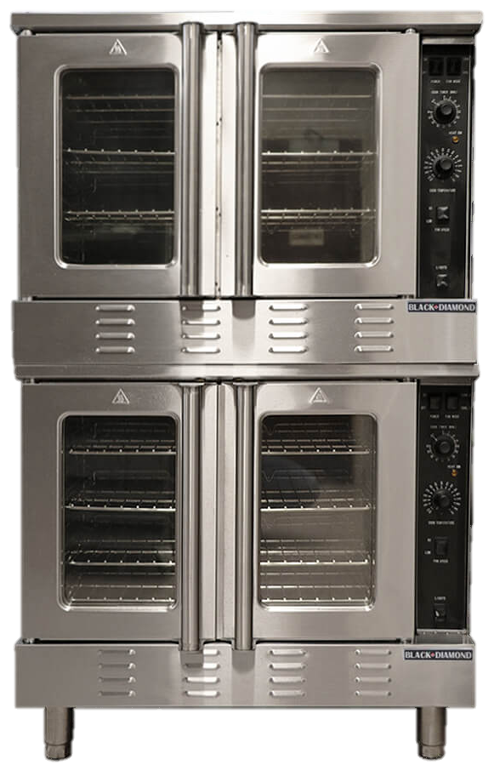
Recipe Cooking Temp’s & Times
Cooking temperatures and times differ between food items. Not everything is cooked at 350°F for 15 minutes. When food is placed in the oven at incorrect cooking settings:
Food can be over/under cooked
Cause a delay in service
Leave customers unsatisfied

Slide 40
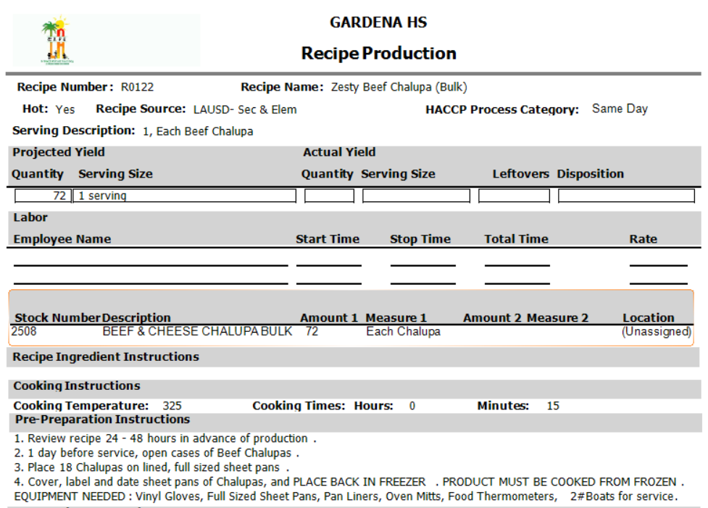
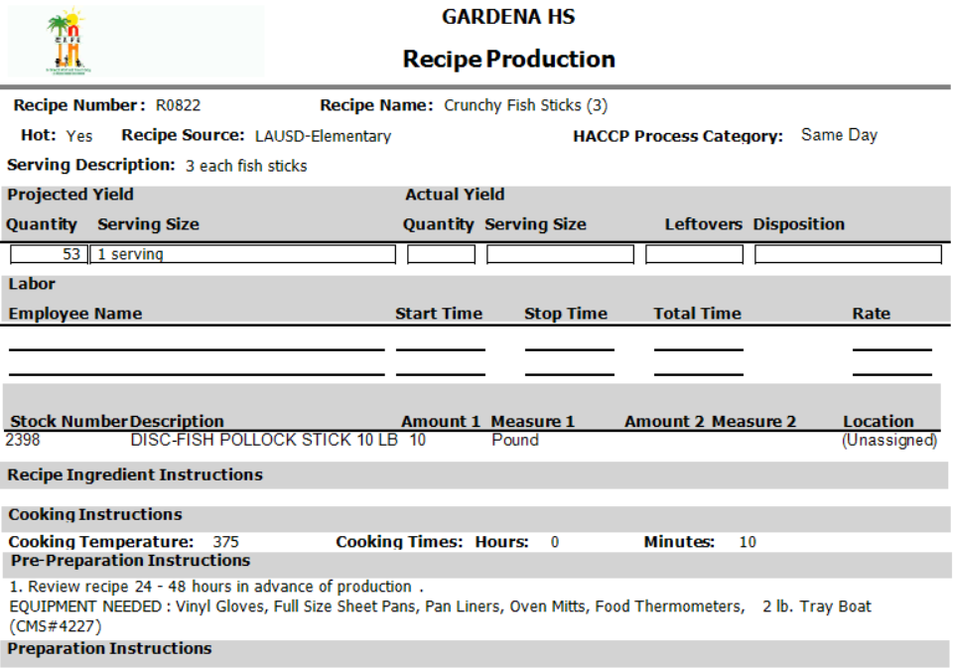
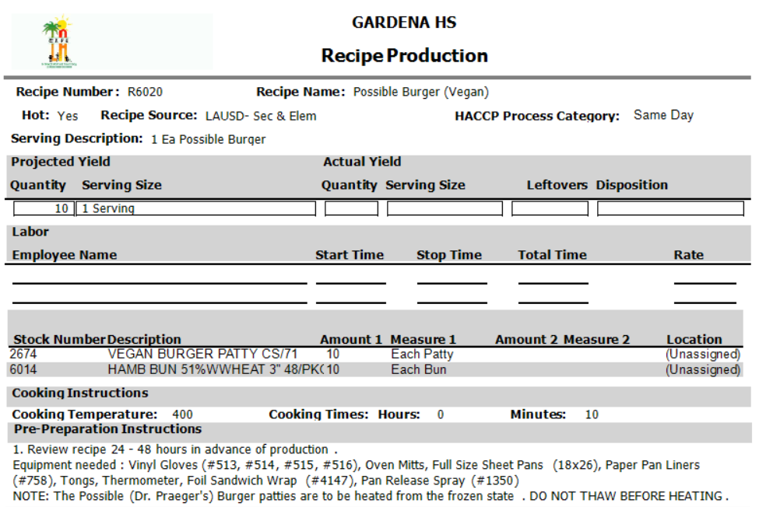
Recipe Review Activity
These recipes show how cooking temperatures and times can vary. On your activity worksheet guess the temperature and time.
Beef Chalupa
Fish Sticks
Possible Burger
325° for 15 min
375° for 10 min
400° for 10 min
Do not assume all items are cooked at the same temperature, always refer to the recipe.

Slide 41
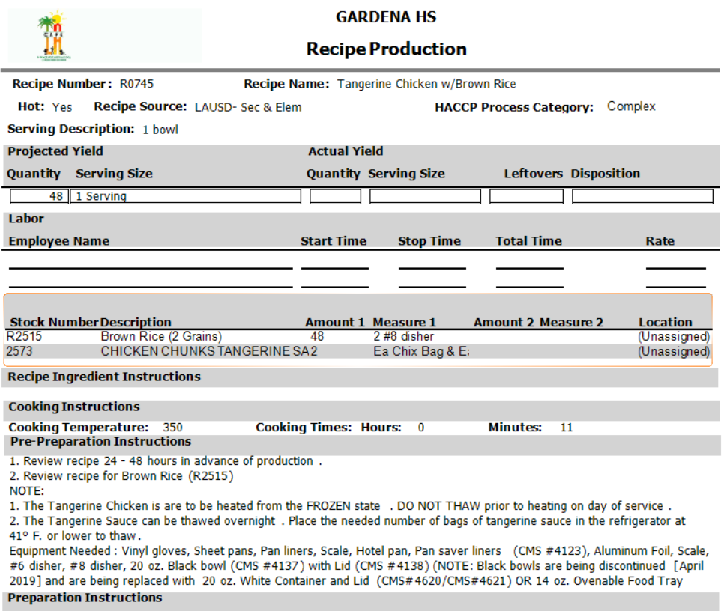
Recipe Review
Food items that sound similar, may be cooked at different temperatures and/or time.
Although these bowls are very similar, they are comprised of different meats which are cooked differently.
Teriyaki Bowl
350° for 20 min
Tangerine Chicken Bowl
350° for 11 min

Slide 42
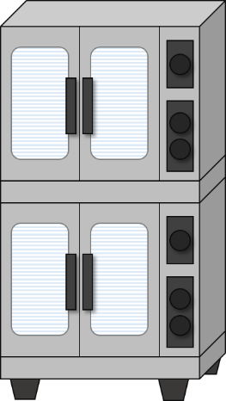
Oven Buzzer Responsibility
A worker is cooking something in the oven and goes on break. The timer goes off while they are away, who’s responsibility is it to check the food in oven?
Cafeteria manager
The one who is cooking
3 hour sub
All the above
Working as a team is important for a successful production. Food quality is everyone’s responsibility.

Slide 43
Resource Waste
Our kitchen equipment utilizes a lot of energy. We are responsible for managing all the resources in our cafeterias; food, labor, water, electricity, and gas.
When making lunch at home, do you turn on the oven first thing in the morning?
Are you comfortable leaving the water run in sink longer than necessary?
Let's all be responsible with our resources. Do not be wasteful.

Slide 44
Customer Focus
Café LA continues to seek the input from our customers. Student voices are helping to drive menu options and variety.
We encourage managers to take feedback from customers and send suggestions to Central Office for menu ideas.

Slide 45
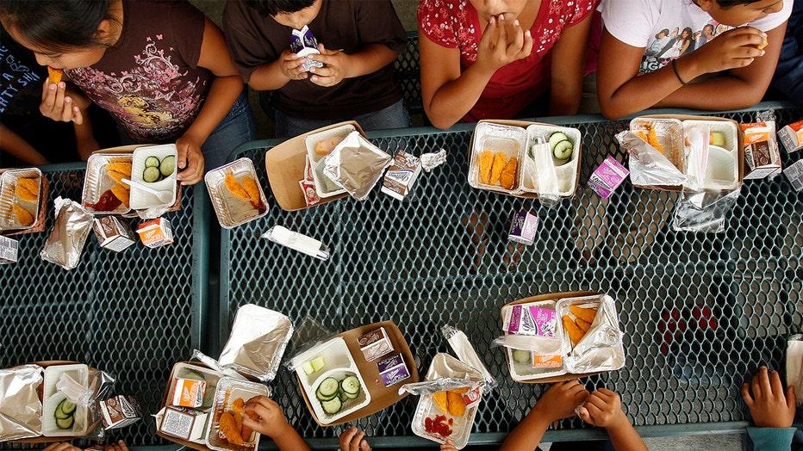
Response to Feedback
A common response from customers was a request for more options during meal services.
Café LA will now be offering a wider variety of entrees during both BIC and Lunch.

Slide 46
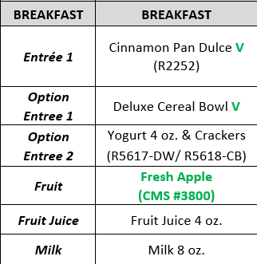
BIC Breakfast Options
BIC returns this school year with 2 entrée options everyday.
Breakfast will have 2 entrées
1 entrée will be either cereal or yogurt
2 fruit options
2 options of milk

Slide 47
Lunch K – 5 Options
Elementary sites will have 3 entrée options everyday
Entrée 1: rotating options
Entrée 2: Café LA favorites
Entrée 3 will be either:
Sandwich, salad or yogurt and granola
2 vegetable options
1 fruit option
Milk

Slide 48
Lunch 6 – 8 Options
Secondary sites grades 6 – 8 must have 3 entrée options everyday
Entrée 1: rotating options
Entrée 2: Café LA favorites
Entrée 3: Salad
Entrée 4: Cold sandwich
2 vegetable options
1 fruit option
Milk

Slide 49
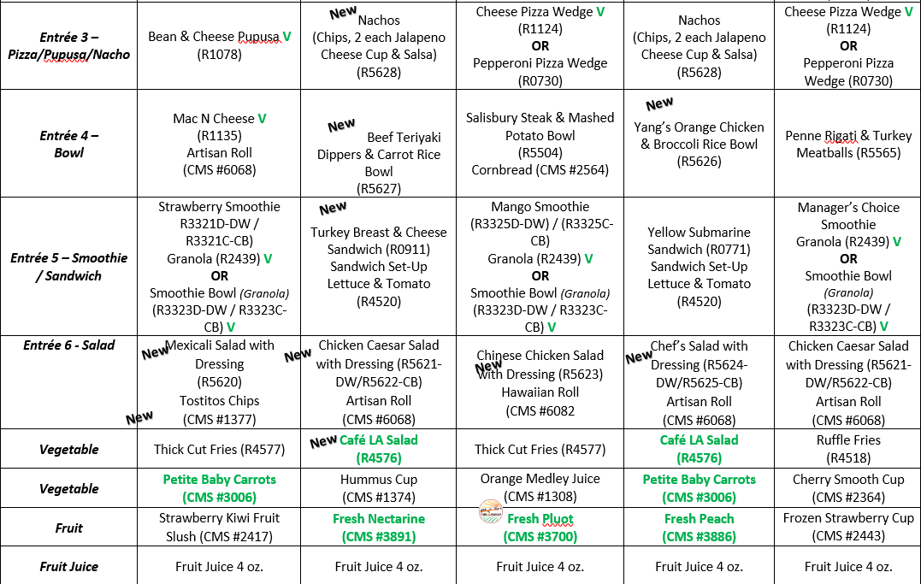
Lunch 9 – 12 Options
Secondary sites grades 9 – 12 will have 6 entrée options everyday
Entrée 1: Burger/hot dog
Entrée 2: Chicken
Entrée 3: Pizza/pupusa/nacho
Entrée 4: Bowl
Entrée 5: Smoothie/sandwich
Entrée 6: Salad
2 vegetable options
2 fruit option: Whole fruit & juice
Milk

Slide 50
Exciting Things To Come
There are exciting new menu options coming to Café LA.
Café LA introduced immersion blenders for smoothies at high schools. Smoothies will soon be rolled out to middle schools this year
A variety of new options will be available for our students during breakfast and lunch
New equipment is being considered for our cafeterias. New equipment means new menu options.

Slide 51
Excited For Café LA
We have plenty of great managers and workers who are passionate about the work they do everyday in our cafeterias.
Let’s listen to a few of our managers.

Slide 52
Share Your Excitement!
We love to hear from our food service managers who are making Café LA a great part of our students day.
Share your stories and cafeteria team pictures with Selina at Selina.Gordian@lausd.net We hope to hear from you.
Thank You!

